Slide 1
Machine learning - clustering
Jayashree M

Slide 2
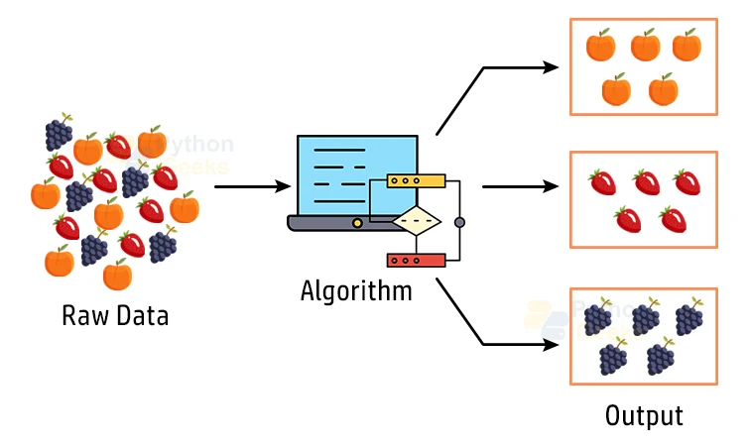
clustering
Clustering is a technique that groups similar data points together into clusters based on their characteristics.
Goal: Discover the natural grouping or structure in unlabeled data without predefined categories.
How: Data points are assigned to clusters based on similarity or distance measures.
Similarity measures: Can include euclidean distance, cosine similarity or other metrics depending on data type and clustering method.
Output: Each group is assigned a cluster id, representing shared characteristics within the cluster.

Slide 3

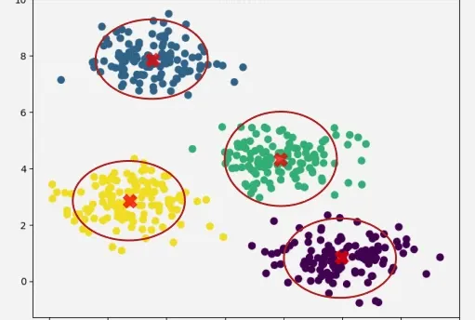
Examples
Targeted marketing
Personalized recommendations
Customer segmentation

Slide 4
Types of Clustering
Data Point | Hard Clustering | Soft Clustering
A | Cluster 1 | Cluster 1: 0.91, Cluster 2: 0.09
B | Cluster 2 | Cluster 1: 0.30, Cluster 2: 0.70
C | Cluster 3 | Cluster 1: 0.17, Cluster 2: 0.83
D | Cluster 4 | Cluster 1: 1.00, Cluster 2: 0.00

Slide 5
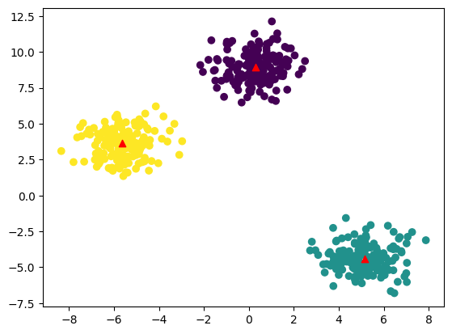
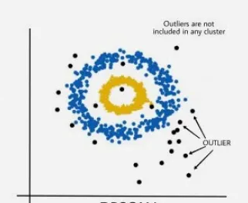
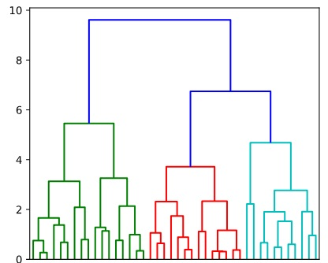
Types of Clustering Methods
Density-based clustering (model-based methods)
Connectivity-based clustering (hierarchical clustering)
Centroid-based clustering (partitioning methods)

Slide 6
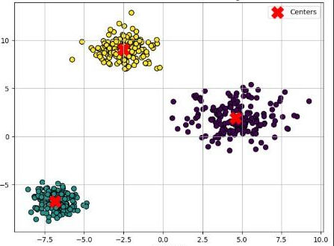
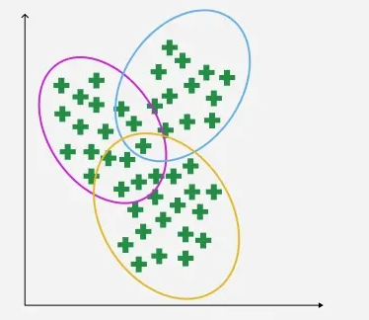
Types of Clustering Methods
Distribution-based clustering
Fuzzy clustering

Slide 7
Types of clustering | Explanation | Algorithms | Advantages | Disadvantages
Centroid-based | groups data by finding central points (centroids) for clusters | K-means K-medoids | Fast and scalable for large datasets. Simple to implement and interpret. | Requires pre-knowledge of k. Sensitive to initialization and outliers. Not suitable for non-spherical clusters.
Density-based | defines clusters as contiguous regions of high data density separated by areas of lower density | DBSCAN OPTICS | Handles clusters of varying shapes and sizes. Does not require cluster count upfront. Effective in noisy datasets. | Difficult to choose parameters like epsilon and min points. Less effective for varying density clusters (except OPTICS).
Connectivity-based | groups data points that are close to each other, forming connected "neighborhoods" and then bigger clusters, | Agglomerative Divisive | Provides a full hierarchy, easy to visualize. No need to specify number of clusters upfront. | Computationally intensive for large datasets. Merging/splitting decisions are irreversible.

Slide 8
Types of clustering | Explanation | Algorithms | Advantages | Disadvantages
Distribution-based | groups data by assuming clusters are shaped like probability distributions (like bell curves), assigning points based on how likely they fit each distribution, not just distance | Gaussian Mixture Model | Flexible cluster shapes. Provides probabilistic memberships. Suitable for overlapping clusters. | Requires specifying number of components. Computationally more expensive. Sensitive to initialization.
Fuzzy clustering | grouping things where items can belong to multiple groups at once, not just one, using "degrees of belonging" | Fuzzy C- means | Models data ambiguity explicitly. Useful for complex or imprecise data. | Choosing fuzziness parameter can be tricky. Computational overhead compared to hard clustering.

Slide 9
K means
Objective: Partition data into K clusters where each point belongs to the nearest mean.
Steps:
1. Choose the number of clusters K.
2. Initialize K cluster centroids (randomly or using smart initialization like K-Means++).
3. Assignment step: Assign each point to the nearest centroid.
4. Update step: Recalculate each centroid as the mean of points assigned to it.
5. Repeat steps 3–4 until centroids stop changing significantly (convergence).
Pros:
Fast, simple.
Cons:
Sensitive to outliers, assumes spherical clusters, requires K.

Slide 10
K medoids
Objective: Partition data into K clusters using actual points (medoids) as centers to reduce sensitivity to outliers.
Steps:
1. Choose the number of clusters K.
2. Select K initial medoids (actual data points).
3. Assignment step: Assign each point to the nearest medoid.
4. Update step: For each cluster, try swapping the medoid with a non-medoid point. Keep the swap if it reduces total distance.
5. Repeat step 3–4 until no medoid change improves the clustering.
Pros:
Robust to outliers, works with any distance metric.
Cons:
Slower than K-Means, expensive for large datasets.

Slide 11
DBSCAN
Objective: Identify dense clusters and label isolated points as noise.
Parameters: eps (neighborhood radius), min_samples (minimum points to form a dense region).
Steps:
1. For each point, find neighbors within eps.
2. Label point as core if neighbors ≥ min_samples, border if reachable from core, otherwise noise.
3. Connect core points with density-reachable neighbors to form clusters.
4. Repeat until all points are processed.
Pros:
Finds arbitrary-shaped clusters, detects noise automatically.
Cons:
Sensitive to eps, struggles with varying density clusters.

Slide 12
OPTICS
Objective: Like DBSCAN but handles clusters of varying density.
Steps:
1. Set min_samples (like DBSCAN), but no fixed eps.
2. Calculate core distance and reachability distance for each point.
3. Sort points based on reachability distance, producing a reachability plot.
4. Extract clusters by identifying valleys in the reachability plot.
Pros:
Handles variable density clusters, identifies hierarchy.
Cons:
More complex, slower, requires interpretation of plot.

Slide 13
Agglomerative Clustering
Objective: Bottom-up hierarchical clustering to form a dendrogram.
Steps:
1. Start with each data point as a separate cluster.
2. Compute pairwise distances between clusters.
3. Merge the two closest clusters based on a linkage method (single, complete, average, Ward).
4. Repeat step 2–3 until only one cluster or desired number of clusters is reached.
5. Optional: Cut dendrogram at a specific level to define clusters.
Pros:
Produces hierarchy, works with any distance metric.
Cons:
Expensive for large datasets, sensitive to early merges.

Slide 14
Divisive Clustering (DIANA)
Objective: Top-down hierarchical clustering.
Steps:
1. Start with all points in one cluster.
2. Identify the point least similar to the rest of the cluster (most distant).
3. Split this point and its nearest points into a new cluster.
4. Repeat splitting recursively on clusters until stopping criterion (number of clusters or homogeneity) is met.
Pros:
Can produce cleaner hierarchy than agglomerative.
Cons:
Very slow, rarely used for large datasets.
**scikit-learn does not offer a direct DivisiveClustering class due to its complexity

Slide 15
Gaussian Mixture Model (GMM)
Objective: Soft clustering assuming data comes from a mixture of Gaussian distributions.
Steps:
1. Choose number of clusters K.
2. Initialize means, covariances, and mixture weights.
3. E-step: Compute probability of each point belonging to each Gaussian (responsibilities).
4. M-step: Update Gaussian parameters (mean, covariance, weights) based on responsibilities.
5. Repeat steps 3–4 until convergence (log-likelihood stabilizes).
Pros:
Handles overlapping and elliptical clusters, probabilistic assignments.
Cons:
Sensitive to outliers, requires Gaussian assumption, needs model selection

Slide 16
Fuzzy C-Means (FCM)
Objective: Soft clustering with degrees of membership for each point.
Steps:
1. Choose number of clusters C and fuzziness parameter m (>1).
2. Initialize membership matrix randomly (values sum to 1 for each point).
3. Compute cluster centers as weighted average of points (weighted by membership^m).
4. Update membership values for each point based on distances to centers.
5. Repeat steps 3–4 until membership changes are below threshold ε.
Pros:
Captures uncertainty, overlapping clusters.
Cons:
Slower than K-Means, sensitive to outliers, needs C.

Slide 17
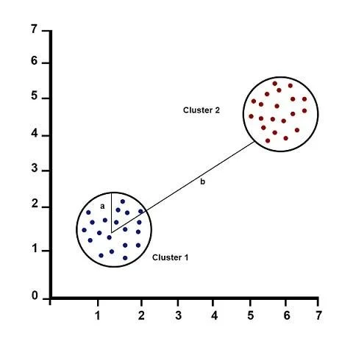
Silhouette Score – Evaluation Metric for Clustering
Used to measure how well each data point fits within its assigned cluster.
Works for any clustering algorithm (k-means, DBSCAN, hierarchical, etc.)
Formula
Silhouette score (s) = (b − a) / max(a, b)
Where:
a= average distance of a data point to other points in the same cluster
b = minimum average distance of the same point to points in other clusters
*The closer the silhouette score is to +1, the better the clustering model.
* A score near 0 means clusters are overlapping.
* Negative values indicate serious misclassification.

Slide 18
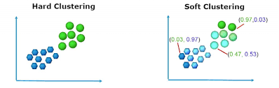
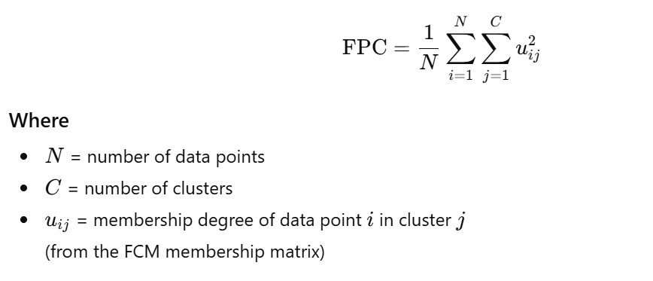
Fuzzy Partition Coefficient (FPC) – Evaluation Metric for Fuzzy C-Means Clustering
Measures how clearly the clustering algorithm assigns data points to clusters.
Based on the membership matrix of fuzzy clustering.
Formula
*Higher FPC(1 or near to 1) = Better fuzzy c-means clustering
*Too low FPC indicates too many clusters or unclear boundaries
Why not silhouette for FCM?
Silhouette assumes hard assignments (one point → one cluster)
FCM uses soft memberships, so FPC is more appropriate

Slide 19
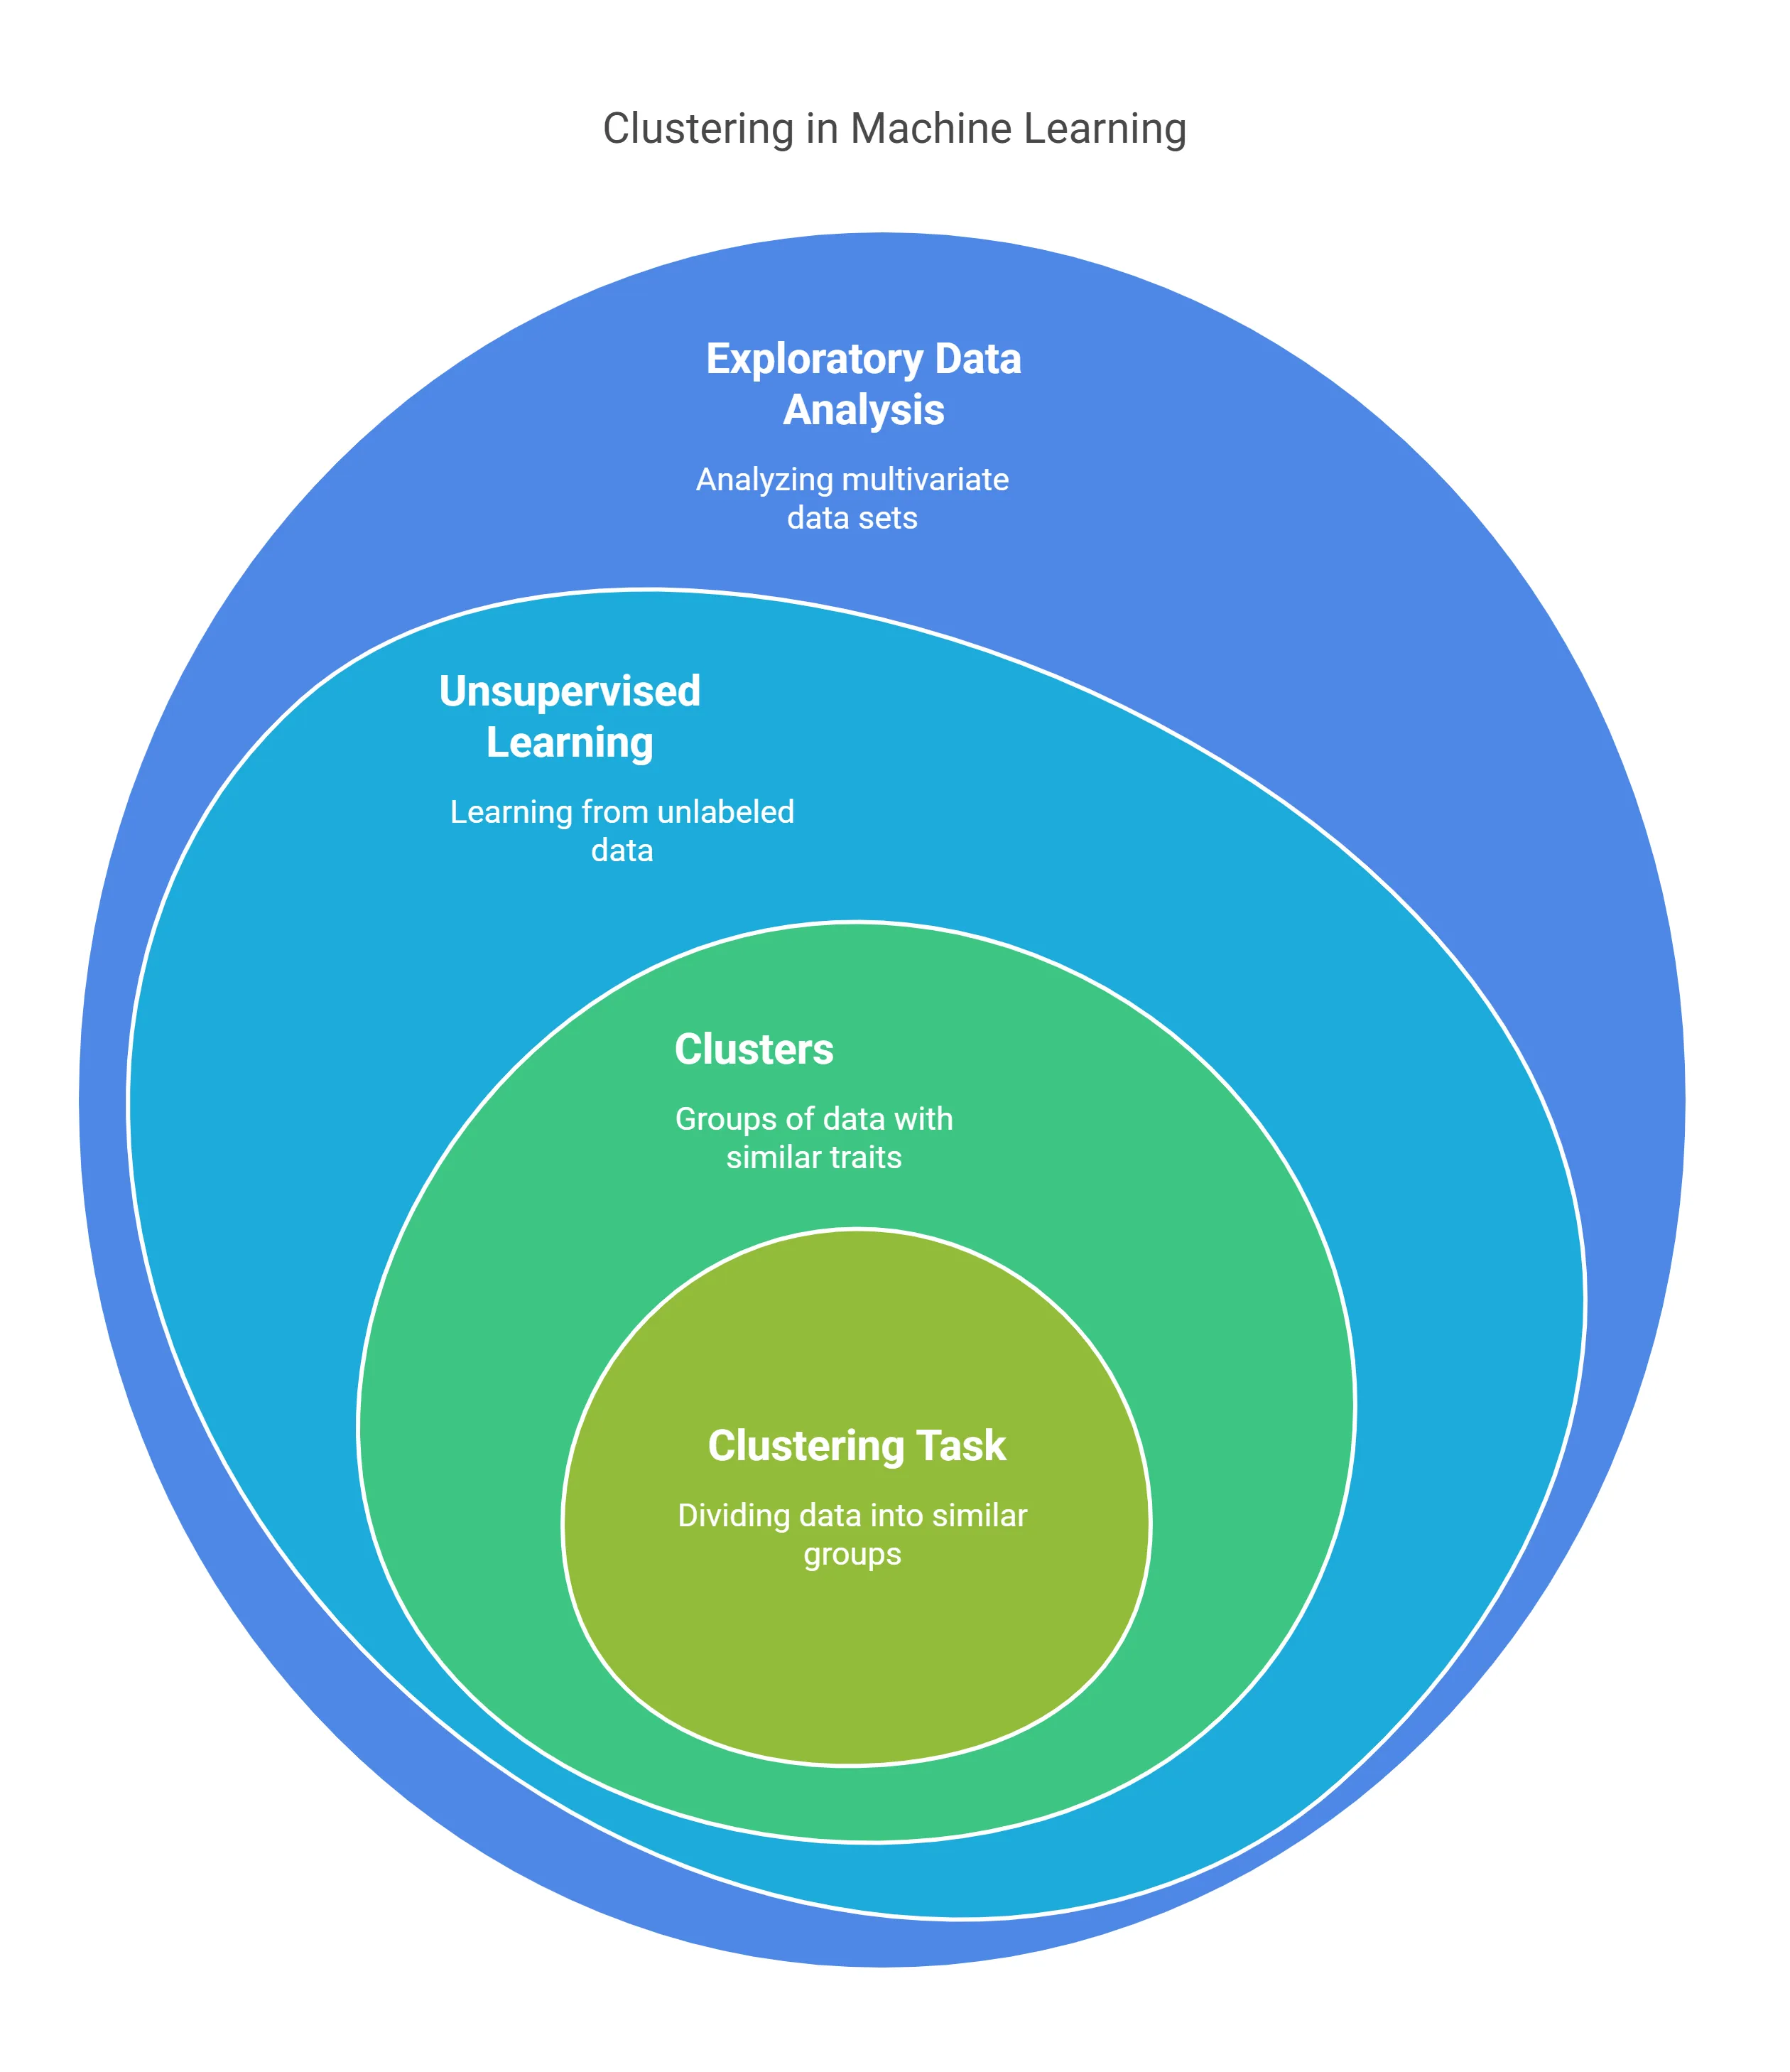
Thank you
Jayashree m

